Slide 1
SAR IMAGE DESPECKLING
ALISHA JOY A

Slide 2
SAR
SAR is a type of active data collection where a sensor produces its own energy and then records the amount of that energy reflected back after interacting with the Earth.
Uses the motion of the radar to create high-resolution images.
Sensor radar refers to a type of radar system used to detect, track, and monitor objects. It operates by emitting radio waves and analyzing the echoes that return after bouncing off objects. This technology is widely used in various fields, including aviation, automotive, meteorology, military, and remote sensing.

Slide 3
Key Components of Sensor Radar:
Transmitter:
Generates the radio waves that are sent out into the environment.
Antenna:
Radiates the transmitted radio waves and receives the echoes.
Can be a single antenna for both transmitting and receiving or separate antennas for each function.
Receiver:
Captures the reflected radio waves (echoes) from objects.
Converts these signals into a form that can be analyzed.
Signal Processor:
Analyzes the received signals to determine the characteristics of the detected objects, such as distance, speed, and size.
Display:
Visualizes the processed data for interpretation by the user.
Can show radar images, plots, or detailed data metrics.

Slide 4
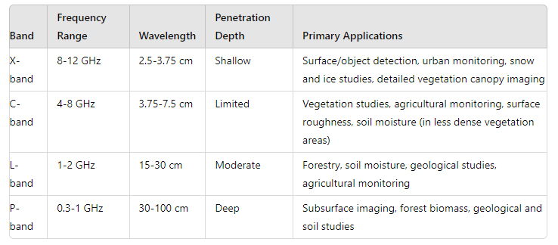

Slide 5

Speckle Formula
Speckle can be modeled mathematically. A common model used to describe speckle noise is the multiplicative noise model, where the observed image I is modeled as the product of the true reflectivity image R and a speckle noise component N:
I=R⋅N
Here, N is often modeled as a random variable following a Rayleigh distribution for single-look SAR images or a Gamma distribution for multi-look SAR images.
Single-Look SAR Images
For single-look images, the speckle noise N is Rayleigh distributed, and the intensity I follows a negative exponential distribution. The probability density function (PDF) for the intensity I is given by:

Slide 6
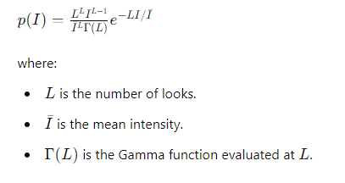
Multi-Look SAR Images
For multi-look images, where the number of looks is L, the intensity I follows a Gamma distribution. The PDF of the Gamma distribution is given by:

Slide 7
THANK YOU

